Slide 1
7.5 Solutions of Linear Systems:
Existence, Uniqueness

Slide 2
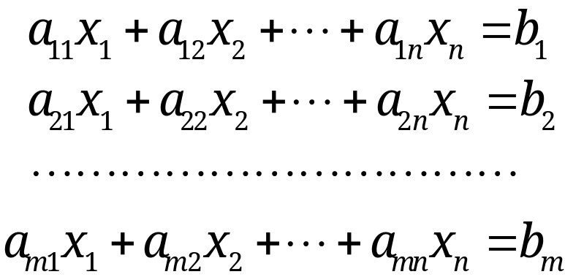
7.5 Solutions of Linear Systems: Existence, Uniqueness
Theorem 1
Fundamental Theorem for Linear Systems
(a) Existence. A linear system of m equations in n unknowns x₁, … ,x_{n}
(1)
is consistent (i.e., has at least one solution) if and only if
rank A = rank Ã.
Section 7.5 p<number>

Slide 3
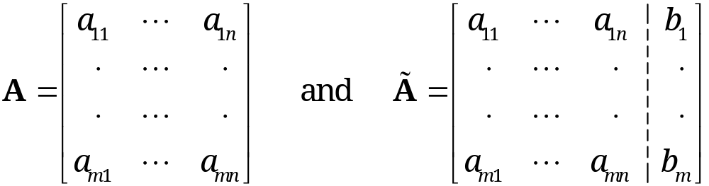
7.5 Solutions of Linear Systems: Existence, Uniqueness
Theorem 1 (continued)
Here, the coefficient matrix A and augmented matrix Ã are defined as
Ã
Remark: Existence of solution depends on whether (1) is consistent or not
Before, we determine consistency or inconsistency via Gaussian elimination
Now, we can look at the problem using matrix rank
Section 7.5 p<number>

Slide 4
7.5 Solutions of Linear Systems: Existence, Uniqueness
Theorem 1 (continued)
(b) Unique solution. The system (1) has a unique solution if and only if rank A = rank Ã = n
(c) Infinitely many solutions. If rank A = rank Ã = r < n, then the system (1) has infinitely many solutions
  All the solutions can be obtained by determining r suitable unknowns (whose submatrix of coefficients must have rank r) after assigning arbitrary values to the remaining n − r unknowns
(d) Gauss elimination. If solutions exist, they can all be obtained by Gauss elimination
Section 7.5 p<number>

Slide 5
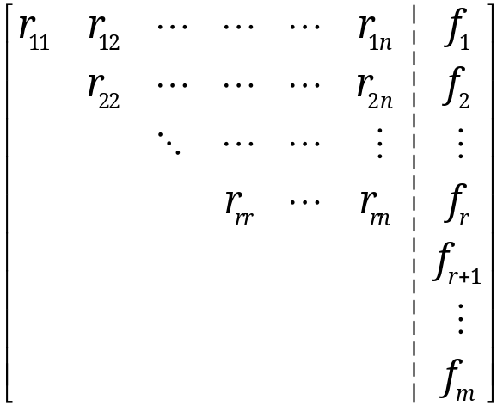
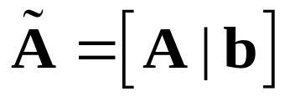
7.5 Solutions of Linear Systems: Existence, Uniqueness
Proof of (a). We apply Gaussian elimination to convert the augmented matrix Ã to its row echelon form
(1) is consistent (i.e., solution exists) if f_{r+1}, f_{r+2}, … , f_{m} are all zero → rank A = rank Ã = r
(1) is inconsistent (i.e., no solution exists) if f_{r+1}, f_{r+2}, … , f_{m} are not all zero → rank A ≠ rank Ã
Thus, (1) is consistent if and only if rank A = rank Ã
Gaussian
elimination
Ã
R
F
Section 7.5 p<number>

Slide 6
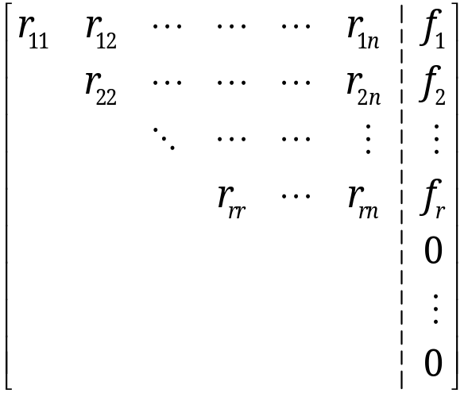
7.5 Solutions of Linear Systems: Existence, Uniqueness
Proof of (b) and (c). Suppose that (1) is consistent or rank A = rank Ã = r . Then, the solution exists. Previously,
Unique solution if number of nonzero rows r = n
Infinite solutions if number of nonzero rows r < n
Since Gaussian elimination does not change the rank of a matrix, a unique solution exists if and only if rank A=n
Gaussian
elimination
Ã
R
F
Section 7.5 p<number>

Slide 7
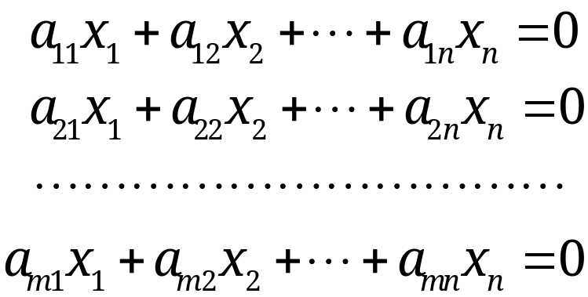
7.5 Solutions of Linear Systems: Existence, Uniqueness
Theorem 2 Homogeneous Linear System
A homogeneous linear system
(4)
always has the trivial solution x₁ = x₂= …=x_{n} = 0, or in vector, x = 0. Nontrivial solutions exist if and only if rank A < n
If rank A = r < n, all solutions (including x = 0) form a vector space of dimension (n − r), called the solution space of Ax=0.
Note: Solutions of nonhomogeneous systems do not form a vector space
Section 7.5 p<number>

Slide 8
7.5 Solutions of Linear Systems: Existence, Uniqueness
Theorem 2 Homogeneous Linear System
A homogeneous linear system
(4)
In particular, if x₍₁₎ and x₍₂₎ are solution vectors of (4), then x = c₁ x₍₁₎ + c₂ x₍₂₎ with any scalars c₁ and c₂ is a solution vector.
Note: Solutions of nonhomogeneous systems do not form a vector space
Section 7.5 p<number>

Slide 9
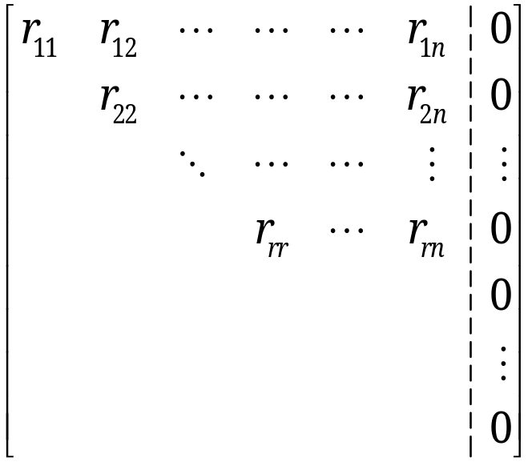
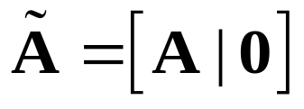
7.5 Solutions of Linear Systems: Existence, Uniqueness
Proof of Theorem 2. Use Gaussian elimination to solve the homogeneous equations:
If rank A=n, then we only have the trivial solution, x=0, for the homogeneous linear system
Gaussian
elimination
Ã
R
F
Section 7.5 p<number>

Slide 10
7.5 Solutions of Linear Systems: Existence, Uniqueness
Proof of Theorem 2 (continued).
If rank A<n, we will have nontrivial solutions, by solving r of variables x₁, …, x_{n} , in terms of the remaining (n-r) free variables (can be assigned arbitrary values). In this case,
  The vector space of all solutions {x_{(i)}} is spanned by (n-r) linearly independent vectors, where Ax_{(i)} = 0 and c₁Ax₍₁₎, + c₂Ax₍₂₎+ … + c_{n-r}Ax_{(n-r)} = 0 leads to c_{i} = 0
  A(c₁x₍₁₎, + c₂x₍₂₎+ … + c_{n-r}x_{(n-r)})= 0 also implies the same, otherwise solution vector derived from c₁x₍₁₎, + c₂x₍₂₎+ … + c_{n-r}x_{(n-r)} breaks condition Ax_{(i)} = 0.
  Hence these (n-r) linearly independent vectors form a basis for such vector space.
  This solution vector space has a dimension (n-r).
Section 7.5 p<number>

Slide 11
7.5 Solutions of Linear Systems: Existence, Uniqueness
The solution space of Ax=0 is also called the null space of A because Ax = 0 for every x in this space. Its dimension is called the nullity of A.
From Theorem 2, we have
(5) rank A + nullity A = n
where n is the number of unknowns (or columns of A)
Section 7.5 p<number>

Slide 12
7.5 Solutions of Linear Systems: Existence, Uniqueness
Theorem 3
Homogeneous Linear System
with Fewer Equations Than Unknowns
A homogeneous linear system with fewer equations than unknowns always has nontrivial solutions.
Proof. From (5), rank A + nullity A = n
nullity A > 0, so nontrivial solutions exist.
Section 7.5 p<number>

Slide 13
7.5 Solutions of Linear Systems: Existence, Uniqueness
Nonhomogeneous Linear Systems
Theorem 4
If a nonhomogeneous linear system (1) is consistent, then all of its solutions are obtained as
(6) x = x₀ + x_{h}
where x₀ is any (fixed) solution of (1) and x_{h} runs through all the solutions of the corresponding homogeneous system Ax = 0.
Section 7.5 p<number>
Notes:
End of first break

Slide 14
7.5 Solutions of Linear Systems: Existence, Uniqueness
Nonhomogeneous Linear Systems
Theorem 4
If a nonhomogeneous linear system (1) is consistent, then all of its solutions are obtained as
(6) x = x₀ + x_{h}
where x₀ is any (fixed) solution of (1) and x_{h} runs through all the solutions of the corresponding homogeneous system Ax = 0.
Proof. First, any solution x in (6) is a solution of (1).
Second, for any solution x of (1), x_{h} = x - x₀ is a solution of Ax = 0 because
A x_{h} = A (x - x₀) = b - b = 0.
Hence, we get all solutions of (1) if we take any solution x₀ of (1) and let x_{h} run through all the solutions of Ax = 0.
Section 7.5 p<number>
Notes:
End of first break

Slide 15
7.6 For Reference:
Second- and Third-Order Determinants

Slide 16
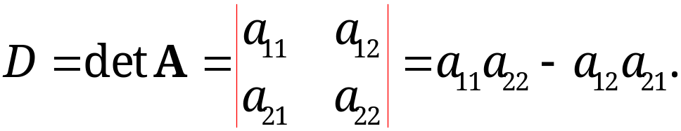
7.6 For Reference:
Second- and Third-Order Determinants
A determinant of second order is denoted and defined for 2 × 2 matrix by
(1)
Note: we denote a determinant with bars (whereas a matrix uses brackets).
Question: Does it have any physical meaning?
  The absolute value of D gives the area of the parallelogram formed by vector [a₁₁, a₁₂] and vector [a₂₁, a₂₂]
Section 7.6 p<number>

Slide 17
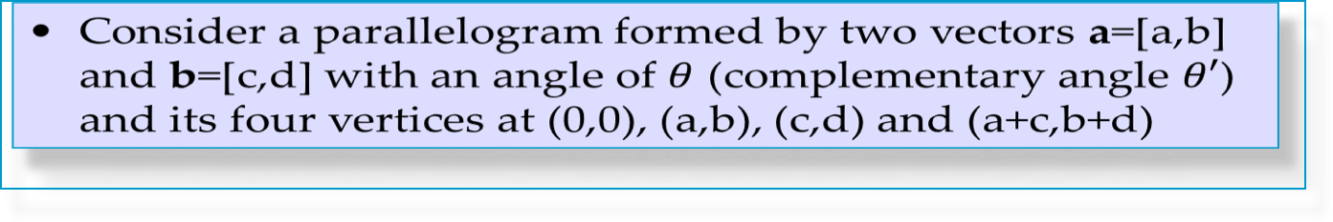
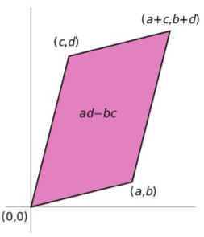

7.6 For Reference:
Second- and Third-Order Determinants
The above determinant gives the area of the parallelogram
3x3 matrix’s determinant is the volume of a parallelepiped
Section 7.6 p<number>

Slide 18
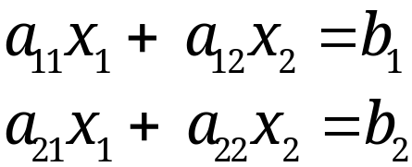
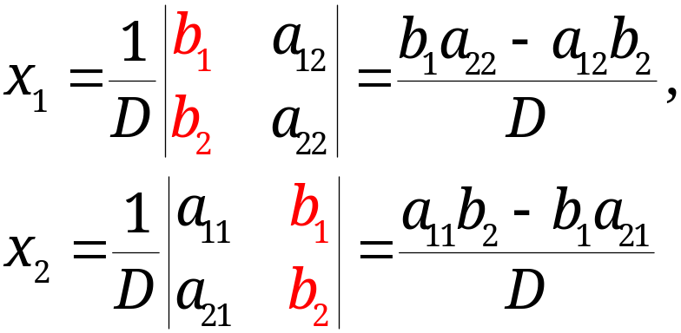
7.6 For Reference:
Second- and Third-Order Determinants
Cramer’s rule for solving linear systems of 2 equations in 2 unknowns
(2)
is
(3)
with D as in (1), provided D ≠ 0.
If D = 0, the homogeneous system has nontrivial solutions.
Section 7.6 p<number>

Slide 19
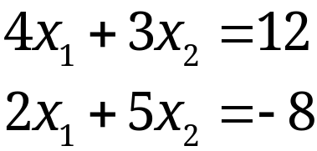
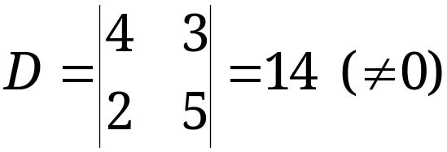
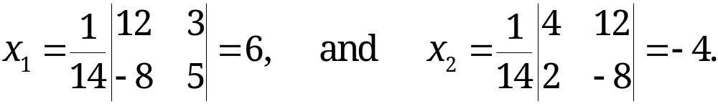
7.6 For Reference:
Second- and Third-Order Determinants
EXAMPLE 1 Cramer’s Rule for Two Equations
Solve the following equations using Cramer’s rule
Solution:
Step 1: calculate determinant D of the coefficient matrix
Step 2: apply Cramer’s rule,
Section 7.6 p<number>

Slide 20
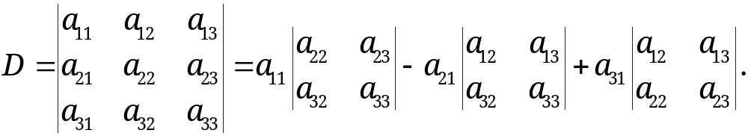
7.6 For Reference:
Second- and Third-Order Determinants
Third-Order Determinants
A determinant of third order for 3×3 matrix can be defined by
(4)
Note:
The signs on the right are + − +
Each of the three terms on the right is an entry in the first column of D times its corresponding minor, which is the second-order determinant obtained from D by deleting the row and column of that entry;
If we write out the minors in (4), we obtain
(4*) D = a₁₁a₂₂a₃₃ − a₁₁a₂₃a₃₂ + a₂₁a₁₃a₃₂ − a₂₁a₁₂a₃₃ + a₃₁a₁₂a₂₃ − a₃₁a₁₃a₂₂.
Any physical meaning?
Minor corresponding to entry a₁₁, a₂₁, and a₃₁
Section 7.6 p<number>

Slide 21
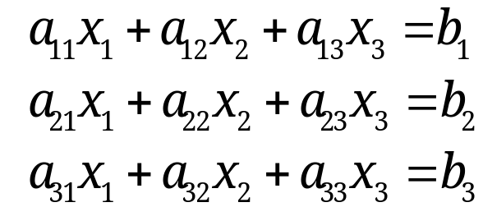
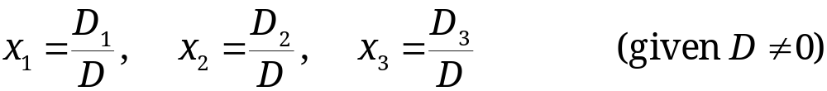
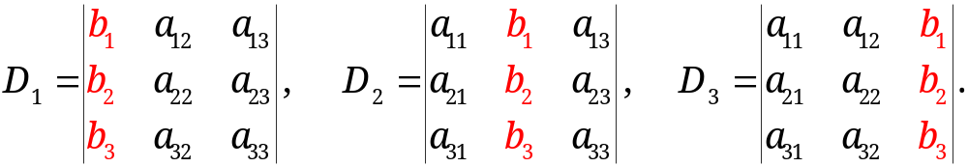
7.6 For Reference:
Second- and Third-Order Determinants
Cramer’s Rule for Linear Systems of 3 Equations and 3 Unknowns
(5)
is
(6)
with the determinant D of the system given by (4) and
Note: D₁, D₂, D₃ are obtained by replacing columns 1, 2, 3 by the column of the right sides of (5), respectively
Section 7.6 p<number>

Slide 22
7.7 Determinants. Cramer’s Rule

Slide 23
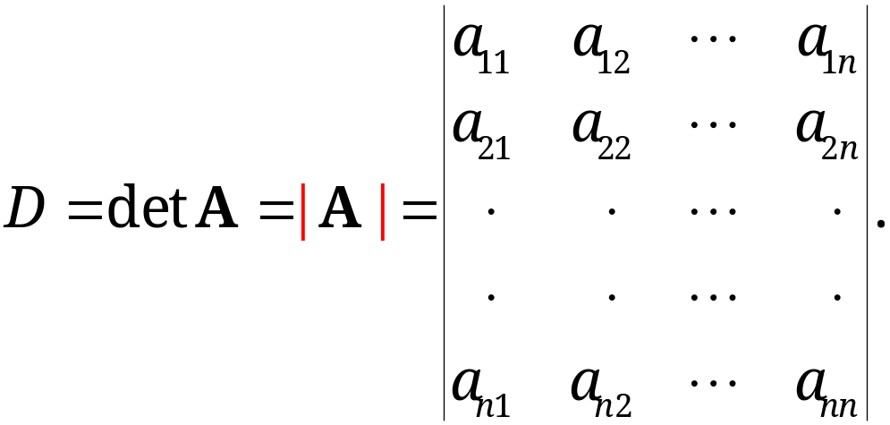
7.7 Determinants. Cramer’s Rule
Definition of Determinant of n × n Matrix
A determinant of order n is a scalar associated with an n × n (hence square!) matrix A = [a_{jk}], and is denoted by
(1)
For n = 1, this determinant is defined by
(2) D = a₁₁.
Section 7.7 p<number>

Slide 24
7.7 Determinants. Cramer’s Rule
Definition of Determinant of n × n Matrix (cont’d)
For n ≥ 2, it is defined by
(3a) D = a_{j1}C_{j1} + a_{j2}C_{j2} + … + a_{jn}C_{jn} ( j = 1, 2, … , or n)
or
(3b) D = a_{1k}C_{1k} + a_{2k}C_{2k} + … + a_{nk}C_{nk} (k = 1, 2, … , or n).
Here,
C_{jk} = (−1)^{j+k}M_{jk}
and M_{jk} is a determinant of order n − 1, i.e., the determinant of the submatrix of A obtained from A by omitting the jth row and the kth column.
Cofactor of a_{jk}
Minor of a_{jk}
Section 7.7 p<number>

Slide 25
7.7 Determinants. Cramer’s Rule
Remarks
The determinant D of order n is defined recursively
  It is defined in terms of n determinants of order n − 1, each of which is, in turn, defined in terms of n − 1 determinants of order n − 2, and so on, until we finally arrive at first-order determinants which are defined by (2)
We may expand D by any row or column, i.e., choose to use in (3) the entries in any row or column
  The result is the same for D no matter which column or row we choose in expanding. (See page A69 of textbook for a proof)
The definition is consistent with that of second and third order determinants in Section 7.6
Section 7.7 p<number>

Slide 26
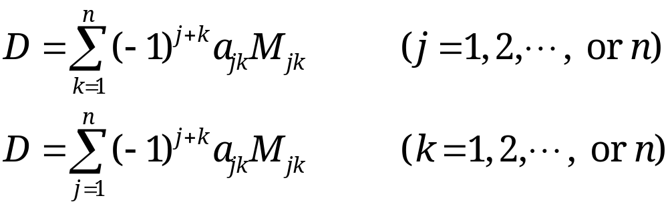
7.7 Determinants. Cramer’s Rule
Terms used in connection with determinants are taken from matrices. In D we have n² entries a_{jk}, also n rows and n columns, and a main diagonal with entries a₁₁, a₂₂, … , a_{nn}
Two new terms
  M_{jk} is called the minor of a_{jk} in D
  C_{jk} is called the cofactor of a_{jk} in D
(3) may also be written in terms of minors
(4a)
(4b)
Section 7.7 p<number>

Slide 27
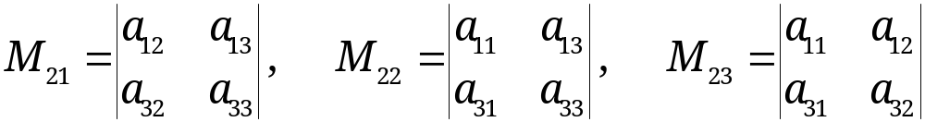
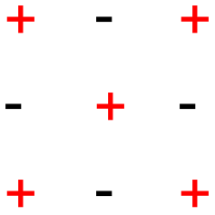
7.7 Determinants. Cramer’s Rule
EXAMPLE 1
Minors and Cofactors of a Third-Order Determinant
In (4) of Section 7.6, the minors and cofactors of the entries in the first column can be seen directly. For the entries in the second row the minors are
and the cofactors are C₂₁ = −M₂₁, C₂₂ = +M₂₂, and C₂₃ = −M₂₃. Similarly for the third row.
Verify that the signs in C_{jk} form a checkerboard pattern
Section 7.7 p<number>

Slide 28
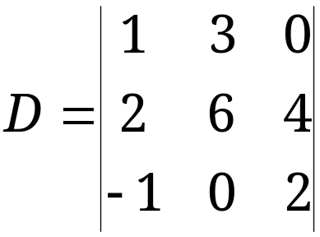
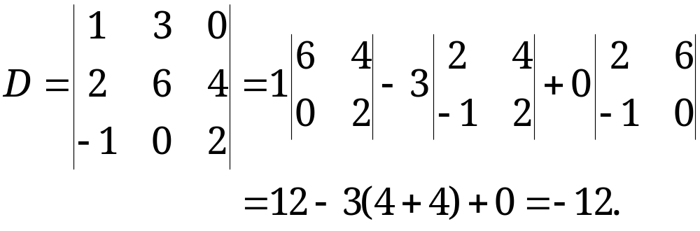
7.7 Determinants. Cramer’s Rule
EXAMPLE 2 Expansions of a Third-Order Determinant
Calculate the following determinant
Solution:
We calculate D by expanding the first row. Then,
Verify that the other expansions also give the value −12.
Section 7.7 p<number>

Slide 29
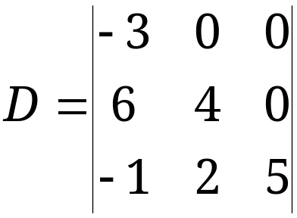
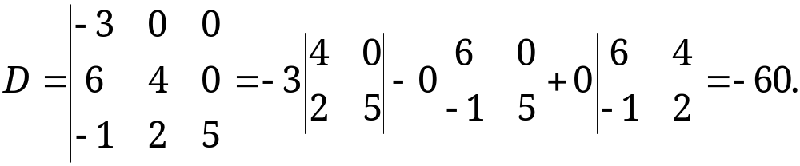

7.7 Determinants. Cramer’s Rule
EXAMPLE 3 Determinant of a Triangular Matrix
Calculate the following determinant
Solution:
We calculate D by expanding the first row. Then,
Question: can you formulate a theorem on determinants of triangular matrices?
Section 7.7 p<number>

Slide 30
7.7 Determinants. Cramer’s Rule
Application of Elementary Row Operations to Determinants
Calculating determinants using its recursive definition above is in general not computationally efficient
Determinant of a triangular matrix is easy to calculate, which is the product of its main diagonal entries
It is possible to calculate determinants by applying elementary row operations to (1) to obtain an “upper triangular” determinant
Caution: determinant values can be changed by elementary row operations.
Section 7.7 p<number>

Slide 31
7.7 Determinants. Cramer’s Rule
THEOREM 1
Behavior of an nth-Order Determinant under Elementary Row Operations
Interchange of two rows multiplies the value of the determinant by −1;
Addition of a multiple of a row to another row does not alter the value of the determinant;
Multiplication of a row by a nonzero constant c multiplies the value of the determinant by c. (This also holds when c = 0, but no longer gives an elementary row operation.)
Caution! det (cA) = c^{n}×det A, not c×det A.
Section 7.7 p<number>

Slide 32
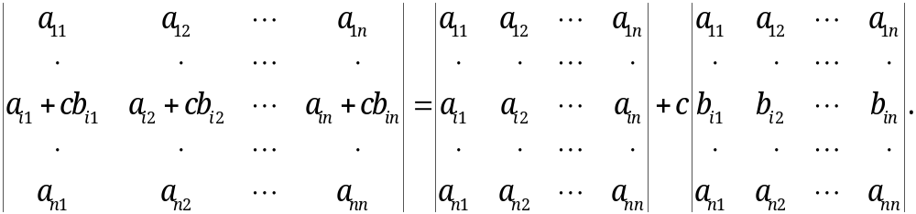
7.7 Determinants. Cramer’s Rule
Key Ideas of Proving Theorem 1
First, it is easy to show by expanding ith row that
Second, it is easy to show by mathematical induction on n that for any n≥2, the determinant of any n×n square matrix with two equal row vectors must be zero
  The result is true when n=2 (by direct calculation)
  The result is true for n if the result is true for n-1 (why?)
  Theorem 1 follows from the above two results (why?)
Section 7.7 p<number>

Slide 33
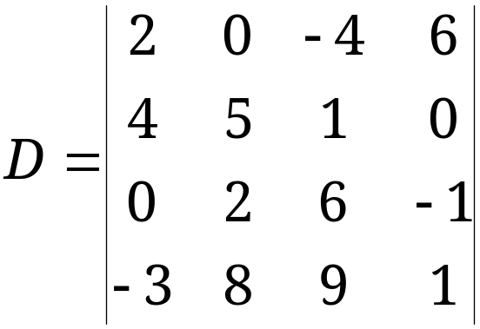


7.7 Determinants. Cramer’s Rule
EXAMPLE 4
Evaluation of Determinants by Reduction to Upper Triangular Form
Because of Theorem 1, we may evaluate determinants by reduction to triangular form, as in the Gauss elimination
for a matrix. For instance,
Section 7.7 p<number>

Slide 34
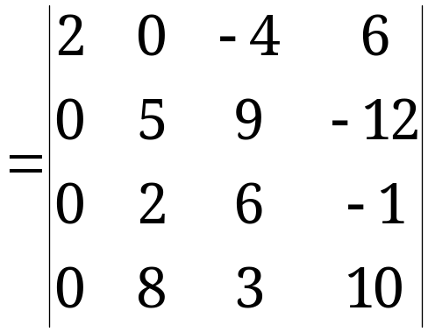


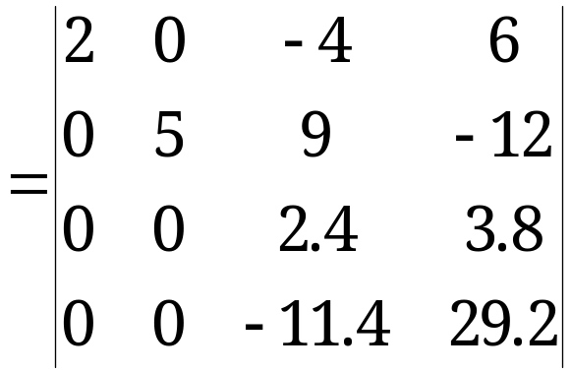

7.7 Determinants. Cramer’s Rule
EXAMPLE 4 (continued)
Evaluation of Determinants by Reduction to Triangular Form (continued)
Section 7.7 p<number>

Slide 35
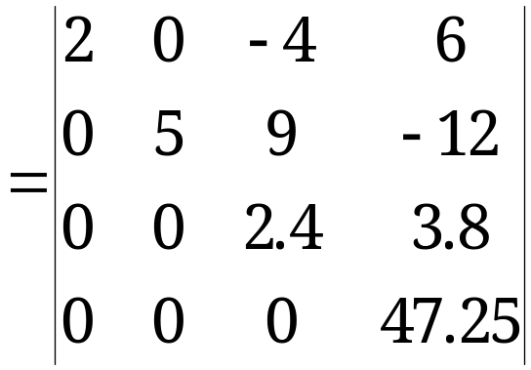
7.7 Determinants. Cramer’s Rule
EXAMPLE 4 (continued)
Evaluation of Determinants by Reduction to Triangular Form (continued)
Section 7.7 p<number>

Slide 36
7.7 Determinants. Cramer’s Rule
THEOREM 2
Further Properties of nth-Order Determinants
(a)–(c) in Theorem 1 hold also for columns.
(d) Transposition does not alter the value of a determinant.
(e) A zero row or column renders the value of a determinant zero.
(f) Proportional rows or columns render the value of a determinant zero. In particular, a determinant with two identical rows or columns has the value zero.
Proof: (a)-(e) follow directly from the fact that determinant can be expanded by any column. (f) follows from proof of Theorem 1
Section 7.7 p<number>

Slide 37
7.7 Determinants. Cramer’s Rule
A submatrix is a matrix formed by selecting certain rows and columns from a bigger matrix.
THEOREM 3
Rank in Terms of Determinants
Consider an m × n matrix A = [a_{jk}]:
rank A = r (≥ 1) if and only if A has an r × r submatrix with a nonzero determinant. (largest r)
(2) In the above case, any square submatrix of A with more than r rows (if it exists) has a zero determinant.
As a special case of (1), if m = n, we have
(3) An n × n square matrix A has rank n if and only if
det A ≠ 0.
Section 7.7 p<number>

Slide 38
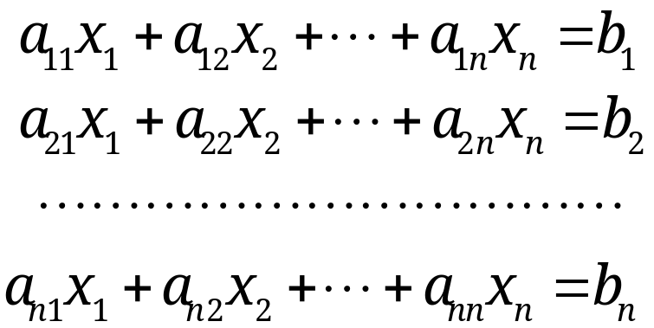
7.7 Determinants. Cramer’s Rule
THEOREM 4 Cramer’s Rule
Cramer’s Theorem
(Solution of Linear Systems by Determinants)
If a linear system of n equations in n unknowns x₁, … , x_{n}
(6)
has a coefficient matrix A with D = det A ≠ 0, then the
system has a unique solution.
One can obtain its solution using Gaussian elimination or the Cramer’s rule
Section 7.7 p<number>

Slide 39
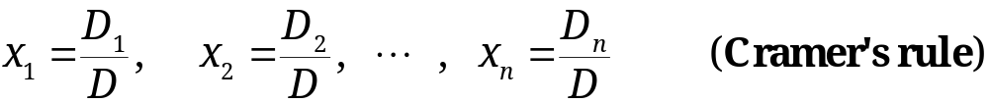
7.7 Determinants. Cramer’s Rule
THEOREM 4 Cramer’s Rule (continued)
The Cramer’s rule solution is given by the formulas
(7)
  where D_{k} is the determinant obtained from D by replacing the kth column in D with a column having entries b₁, … , b_{n}.
By Cramer’s rule, if the system (6) is homogeneous and D ≠ 0, it has only the trivial solution x₁ = x₂ = … =x_{n} = 0. If D = 0, the homogeneous system also has nontrivial solutions.
Note: the proof of Cramer’s rule will be given in Section 7.8
Section 7.7 p<number>

Slide 40
Announcements
Assignment 1 is now released, due on 6:30PM, Feb 10
Submission to collection box C18 @ 5/F of ERB

Slide 41

Announcements
Assignment 1 is now released, due on 6:30PM, Feb 10
Submission to collection box C18 @ 5/F of ERB

